Slide 1

PC builder web application
Team member:
Kevin Song
Siyuan He
Xu Zhang
Haimiao Yu
Chhanna Gaha
Sichao Liu
Guided By: Professor Henry Wong
Deliverable II
Team Name: Dice

Slide 2

Introduction
A new application is made if a developer produces a new idea or when there is new technology to create better software. Our team viewed many existing online PC hardware stores, they are either created with older development tools or lacking functions that we need nowadays.
Therefore, we are here with a web application that is developed using React and other advanced technologies to achieve smooth browsing and satisfying functionality. This web app will guide students and users who have less experience on PC hardware to pick the right parts. Also, it will help experienced PC shoppers fulfill their dream of building their own pc.

Slide 3
Persona of a college Student
Hi, I am Nancy studying Bachelor's in Computer Science at North Georgia University. It’s difficult for me to pick a laptop out of many brands. There are ASUS, MSI, Dell and so many famous brands with similar hardware specs. I wish there is a good online application to help me identify which brand has the best hardware with the best price.

Slide 4
Persona of a software engineer
Hi, I am Jz Han. I am an experienced IT worker living in the Georgia suburb. In Georgia, the retail store is far away from where I live so I always shop for PC parts online. However, the websites that I am familiar with are only office related. They do sell PC hardware but it’s not their major business. I wish there was a web application that would just focus on selling PC parts. It would need to have a clear category breakdown and run smoothly just like any other shopping website.

Slide 5
Persona of a FilMmaker
Hi, my name is Mark. I’m an MFA of Filmmaking in the School of Visual Arts in New York. Next semester I will take classes related to video editing and color correction and I’m using 4K videos instead of 1080p videos. So I’m changing my main editing tool from Adobe Premiere to Davinci Resolve. I have a great Gaming Desktop and it worked well with Premiere, but after moving to Davinci it runs much slower. I was told that different professional software sometimes make more use of different components of the PC. When I was trying to find which part of my PC should be replaced, I found that all the current PC building websites separated their PC builds into categories like gaming PC, creator PC, or office PC. It would be helpful to have a PC Building website which can make buying suggestions based not only on the main use, but also based on the specific workflow and tools.

Slide 6
Persona of a Gamer
Hi, I am Jessi, a Bachelor at Pace University. I’m a big fan of AAA PC gaming so I plan to buy a powerful laptop which can be used for heavy gaming as well as course work. The existing PC websites only show the specs of the laptops. However, the gaming performance is not only related to the specs on the laptop. The thermal strategy, TDP settings, power management, and even pre-installed software will affect the gaming performance in the real world. These detailed information are not shown on existing websites. It would be great to have a website to show me the real gaming performance of each laptop to help me make purchase decisions.

Slide 7
Product Backlog
# | Tasks | Features | Date | Priority
1 | Brain Storming | Every team members shared ideas. We, as a team decided the topic for the project. | 08/33/2020 to 09/07/2020 | High
2 | Requirement Gathering | Gathering all the required information that will be helpful to the project. | 09/07/2020 to 9/15/2020 | Moderate
3 | Research on technologies | Group discussion about what technologies to be used in our web application. | 09/17/2020 to 9/20/2020 | High
4 | Creating user login page | We had started planning and designing the user interface. | 09/25/2020 to 9/28/2020 | Moderate
5 | Creating backend | We had started learning firebase and were trying to connect it to our interface. | 09/29/2020 to 10/02/2020 | High

Slide 8
User Stories & Acceptance Criteria
User Story | Criteria
As a User, I want to login to the website. I can freely create an account using my email address. | When users visit the website, they must first see the main page with login and register window. They can fill the registration form if they are a new user or login directly.
As a Web admin, I want to differentiate my account management from normal user. | An admin account is only creatable through backend. They can also login from the website admin login page by using password and Email.

Slide 9
User Stories & Acceptance Criteria
User Story | Criteria
As a web app manager, I want to verify the existence of a new user’s Email. | When User fills registration form and completes registration, an Email with link should be sent to the same Email to verify the account. User must click the link within the Email to complete registration.
As a Web admin, I want to login to the website with ability to manage other accounts or create new items. | Once Web admin logs in, they can click on a specialized tab to perform various activities which include: Creating, retrieving, updating and deleting users or products Etc.…

Slide 10
Test Case
Scenario | Test Cases | Test Data | Expected Result
Create Account | Sign up with Email and password Error if the Email is not in correct format Remind User if Password is wrong Remind User if Password is shorter than 6 characters. Successful Register after input Email, Password in correct format | Email: applebee@gmail.com Password: 111345p | User should complete registration and be redirected to their Home page. Only Email with certain format can register. If not, an error message : “The email address is badly formatted.” will pop up. Incorrect Password will get an error message: “The password is invalid.” After User registers, they will be automatically sent to Home page.
Login Form | Sign in with valid Email address and password Reach User’s Home page Error message for too many incorrect attempts | Same Email and Password From Register | User should be able to login with email and password. They will redirect to homepage after login Message: “too many attempts” will pop up to prevent bot spam.
Log Out | After entering to user’s page, refreshing the page will not redirect. Click Log Out button can redirect back to Login/Register Page. |  | Refresh page will not drop user connection. They will stay logged in until manually logged out.

Slide 11

Project demo

Slide 12
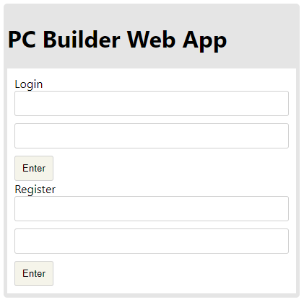
Our main page

Slide 13
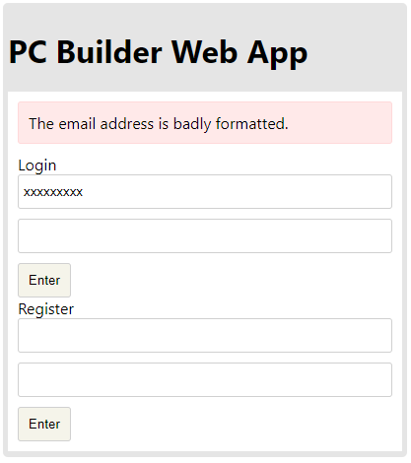
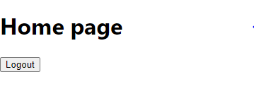
Any incorrect Email format will prevent User from Registration.
Successful login leads to Home Page. User info are stored in google firebase.

Slide 14
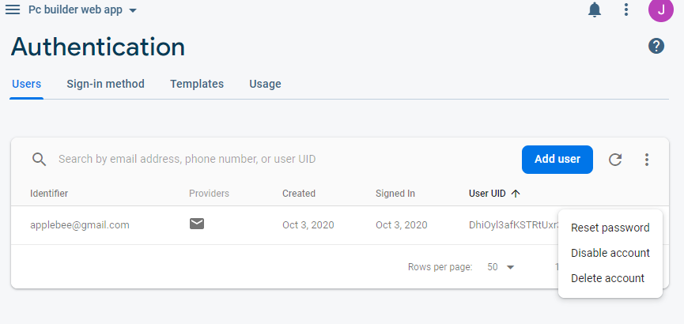

Slide 15
Sprint backlog
Team Dice Deliverable 1
What went well | Votes
Brainstorming | 1
Clear division of work | 2
All members share their ideas | 1
What can be improved
Work on a presentation skills | 4
Rethinking about tools | 1
Contribution from every team member | 2
Sprint 1
Finalized project ideal | Gather information and technologies

Slide 16
Sprint backlog
Team Dice Deliverable II
What went well | Votes
Successfully created Login/Register page | 4
Successfully created firebase to store user’s data | 3
Web App can check and response to wrong input | 3
What can be improved
Email verification system still have error | 2
Time Management | 4
Background image to the homepage | 3
Sprint II
Made part of the project UI | Started on Implementation of Database

Slide 17

Future scope
We could merge the login & register input field
More scrum meeting virtually
Create admin page and function
Add a product list
Fix the error Email verification system

Slide 18

GitHub link
https://github.com/ksong227/CS691TeamDice
Thank You

